Slide 1
Problem Statement
Protecting the user password keys at rest (on the Disk)
File security helps protect sensitive and confidential information from being accessed by unauthorized individuals.
File security refers to the methods and techniques used to protect files and data from unauthorized access, theft, modification, or deletion. It involves using various security measures to ensure that only authorized users can access the files, and that the files are protected from malware, viruses, and other security threats.

Slide 2
Unique Idea Brief (Solution)
Encryption involves converting data into a coded format that can only be accessed by those with the correct decryption key—protecting your sensitive data from unauthorized access.
Data encryption is a security method where information is encoded and can only be accessed or decrypted by a user with the correct encryption key. Encrypted data, also known as ciphertext, appears scrambled or unreadable to a person or entity accessing without permission.
To do these there are many encryption algorithms such as:
AES. The Advanced Encryption Standard (AES) is the trusted standard algorithm used by the United States government, as well as other organizations. Although extremely efficient in the 128-bit form, AES also uses 192- and 256-bit keys for very demanding encryption purposes.

Slide 3
Blowfish. Blowfish is another algorithm that was designed to replace DES. This symmetric tool breaks messages into 64-bit blocks and encrypts them individually. Blowfish has established a reputation for speed, flexibility, and is unbreakable. It’s in the public domain, so that makes it free, adding even more to its appeal.
Rivest-Shamir-Adleman (RSA). Rivest-Shamir-Adleman is an asymmetric encryption algorithm that works off the factorization of the product of two large prime numbers. Only a user with knowledge of these two numbers can decode the message successfully.
This project is implemented using AES(256) algorithm.

Slide 4
Features Offered
Drive Encryption: With the ability to encrypt user-selected files or directories, AES-256 Encryption – Strong AES-256 encryption algorithm for data protection.
Random Key Creation- Generates a new File Encryption Key (FEK) for each encryption operation.
Passphrase Protection — Encrypted data is only accessible with a user-provided passphrase.
KDF (Key Derivation Function): Invokes a KeyDeriviationFunction to generate secure keys based on user passphrase.
Storage Service for Keys: Encrypt the FEK itself and use derived key to protect it.
Plaintext Storage Avoidance - Never store a user's passphrase, nor the FEK itself in plaintext.
Process : Process execution to securely decrypt based on the correct passphrase
Workflow– Separation of Key & User
• Separation of concerns: Isolates FEK from passphrase ( consumer supplied secret)

Slide 5
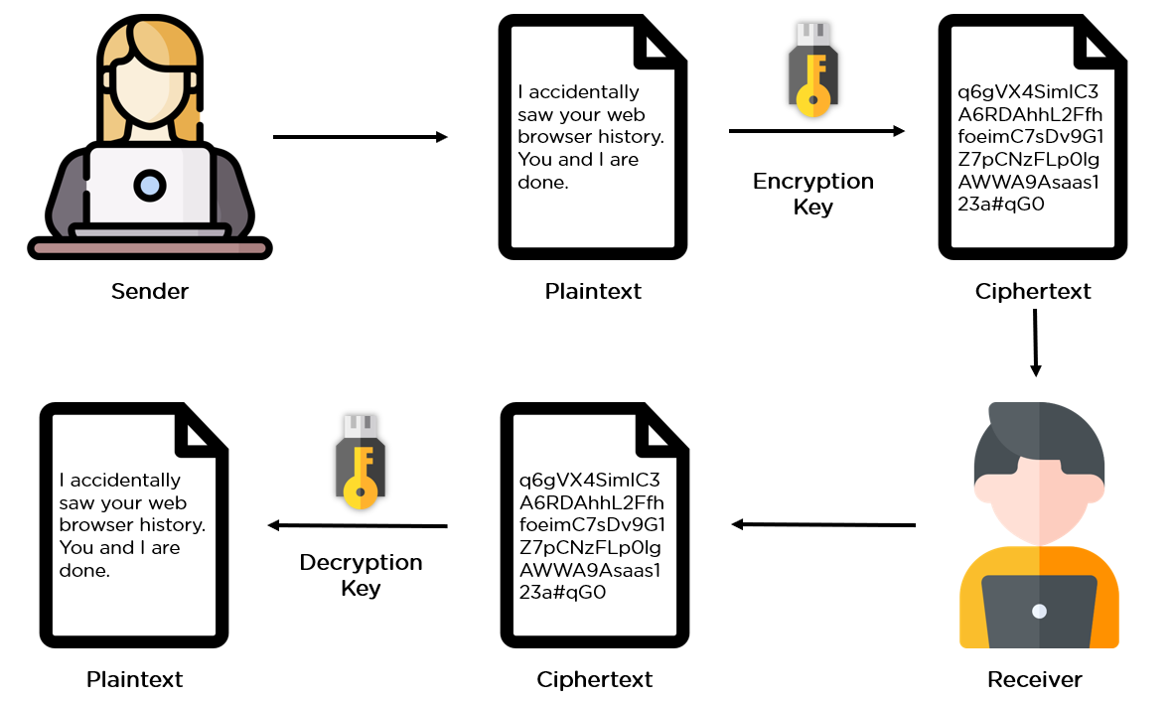
Process flow

Slide 6
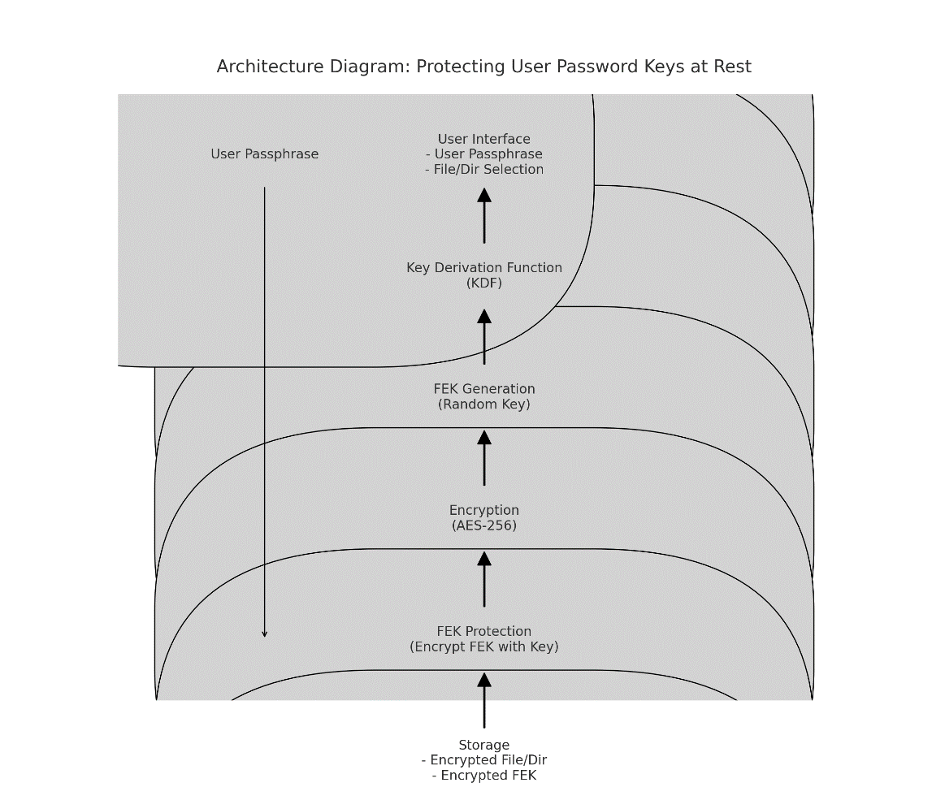
Architecture Diagram

Slide 7
User Passphrase : A User's initial input. It is what function as the password that secures their account or data.
Select User Salt/Secret - The user chooses a salt or secret value as well. A 'salt' is an arbitrary string of characters and helps to increase the security by making it more difficult for attackers to crack a pass-phrase.
Key Derivation Function (KDF): The KDF accepts the user passphrase and a salt as arguments. Creates a Key Encryption Key (KEK) KEK - A safe key, used for encrypting the tiered Key.
FEK Generation (Random Key): This is a third type of FEK, produced by combining the KEK with some random key generation function. The FNK is specific to the user per session.

Slide 8
Type of encryption (AES-256): The FEK is used to encrypt any user files or directories which contain sensitive data. AES-256: This is the Advanced Encryption Standard with a 256-bit key, this algorithm is as strong for encryption efforts.
FEK Protection — Encrypt FEK with Key: The same key, known as a master key to protect the encrypted message is required. This means that this way, even if the encrypted FEK is leaked ,the real FEK still safe.
Storage (Encrypted File): This will keep everything encrypted along with the new FEK, and then store it safely. Thus, it ensures that the Password keys are protected even if they not in use.

Slide 9
Technologies used
Anaconda navigator
Spyder
Anaconda navigator
Anaconda Navigator is a desktop graphical user interface (GUI) included in Anaconda® Distribution that allows you to launch applications and manage conda packages, environments, and channels without using command line interface (CLI) commands.
Anaconda is a distribution of the Python programming language that is quite popular. It is designed specifically for machine learning and data science. There are more than 1,500 pre-installed packages that Anaconda comes with.

Slide 10
Spyder
Spyder is a free and open-source scientific environment for Python, combining advanced analysis, debugging, editing, and profiling with data exploration. Spyder features a multi-language editor pane to create, open, and modify source files.
Spyder is an open-source cross-platform integrated development environment (IDE) for scientific programming in the Python language. Spyder integrates with a number of prominent packages in the scientific Python stack, including NumPy, SciPy, Matplotlib, pandas, IPython, SymPy and Cython, as well as other open-source software.
It is available cross-platform through Anaconda, on Windows, on macOS through MacPorts, and on major Linux distributions such as Arch Linux, Debian, Fedora, Gentoo Linux, openSUSE and Ubuntu.

Slide 11

Team members and contribution:
TEAM GUIDE:
NAME | Dr. JAGADHEESH PATIL | PICTURE
G-MAIL | jagadishmalipatil@gmail.com
Contact number | 9036511203
Contribution | Guide and mentor

Slide 12

TEAM MEMBER 1 (TEAM LEAD):
NAME | PAVAN | PICTURE
G-MAIL | ppgonalkar@gmail.com
Contact number | 6360913377
Contribution | Code and GUI development

Slide 13
TEAM MEMBER 2:
NAME | GANESH
G-MAIL | ganeshekbote04@gmail.com
Contact number | 9035441755
Contribution | Error debugging and modifying

Slide 14
TEAM MEMBER 3:
NAME | NIHKIL METRI
G-MAIL | nikhilgmetri2001@gmail.com
CONTACT NUMBER | 7090820009
CONTRIBUTION | Report building and presentation making

Slide 15
Conclusion
The Secure File Protector project is successful and meets its objectives with a user-oriented file encryption/decryption solution based on AES-256 levels of security. Using a cryptography library will help ensure that cryptographic operations follow best security practices. But this could be improved by having valid error handling, i.e. to specifically catch some exceptions and give a more clear message in each case instead of just raising the exception.
In general the Secure File Protector project is a great start for those who would like to encrypt or decrypt any kind of files safely. With powerful encryption, a low barrier to entry and modular design Spectrum is worth looking into when it comes from restricting access in sensitive situations. The following points gives an overview of what the project does in terms of how it works and why:
1. Security
2. User Interface
3. Implementation
4. Areas for Improvement

Slide 16
THANK YOU

